Slide 1
MGS 723: Geodynamics
Class 24: Convection I
Main reference for today: Turcotte and Schubert textbook (Ch. 6)

Slide 2
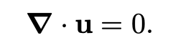

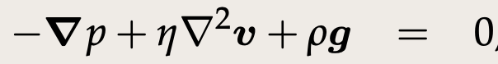
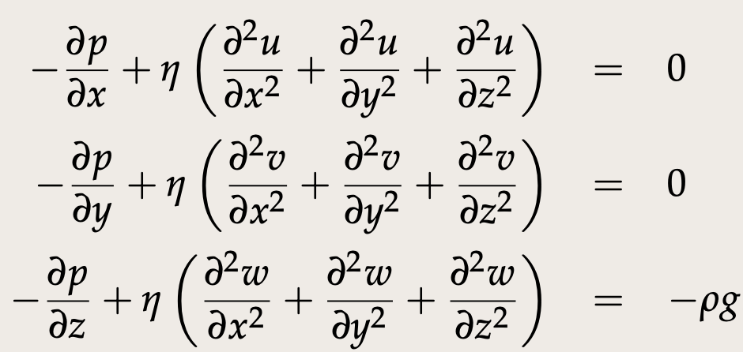
Recap: Stokes flow
Conservation
of mass
Conservation
of momentum
Vector form:
In full (Cartesian):
Notes:
https://www3.nd.edu/~cneal/PlanetEarth/Chapt-11a-Rock-Mechanics.pdf

Slide 3
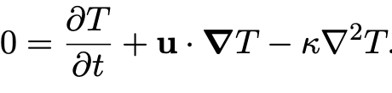
Recap: Stokes flow
Conservation
of mass
Conservation
of momentum
Vector form:
In full (Cartesian):
Conservation
of energy
Notes:
https://www3.nd.edu/~cneal/PlanetEarth/Chapt-11a-Rock-Mechanics.pdf

Slide 4
Recap: Stokes flow
Conservation
of mass
Conservation
of momentum
Vector form:
In full (Cartesian):
convection
Conservation
of energy
Notes:
https://www3.nd.edu/~cneal/PlanetEarth/Chapt-11a-Rock-Mechanics.pdf

Slide 5
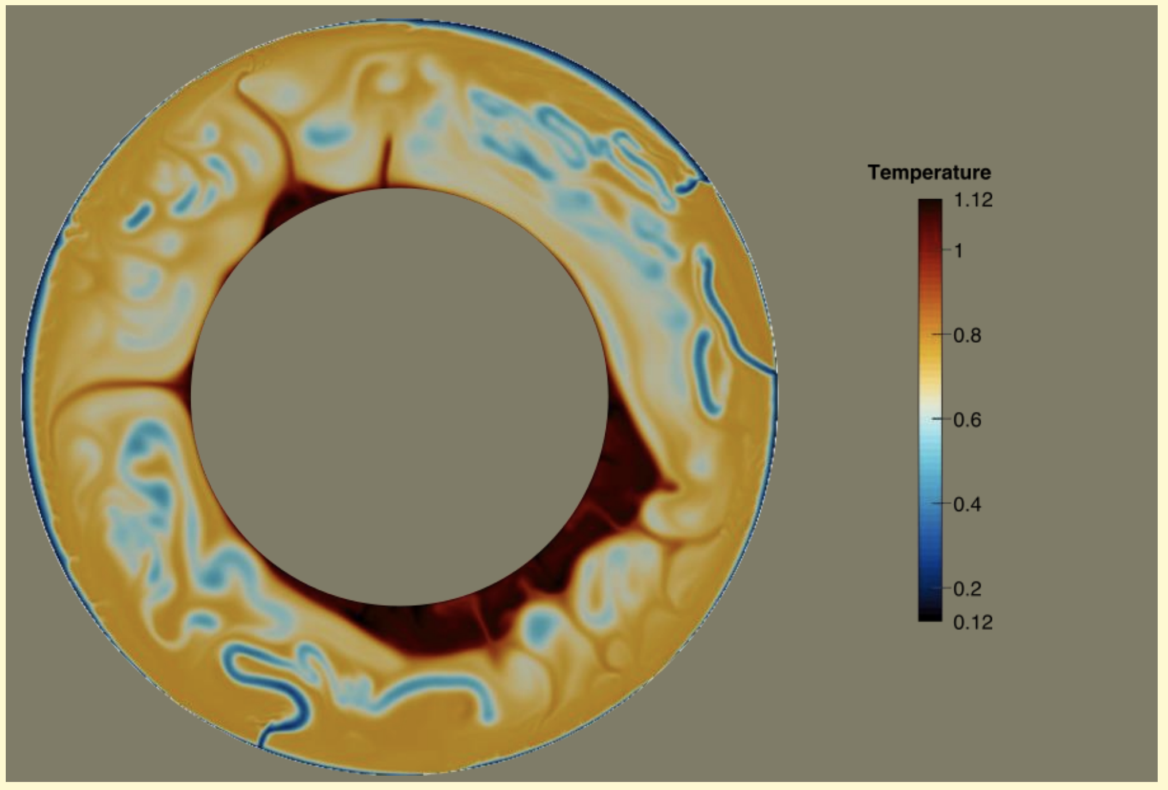
A convection model

Slide 6
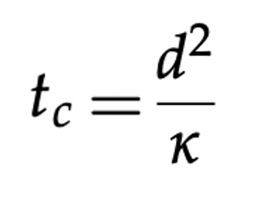
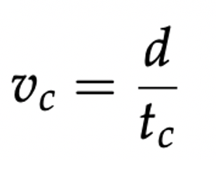
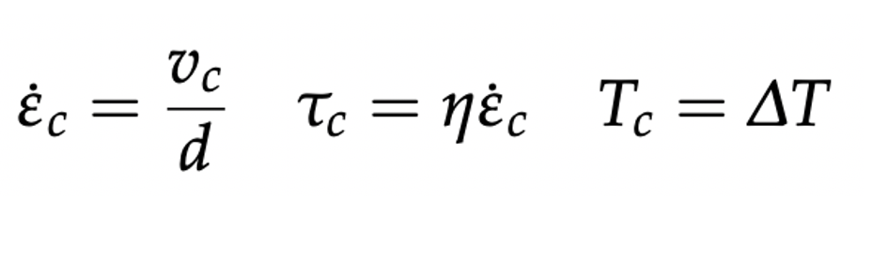
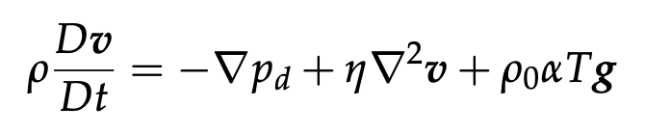
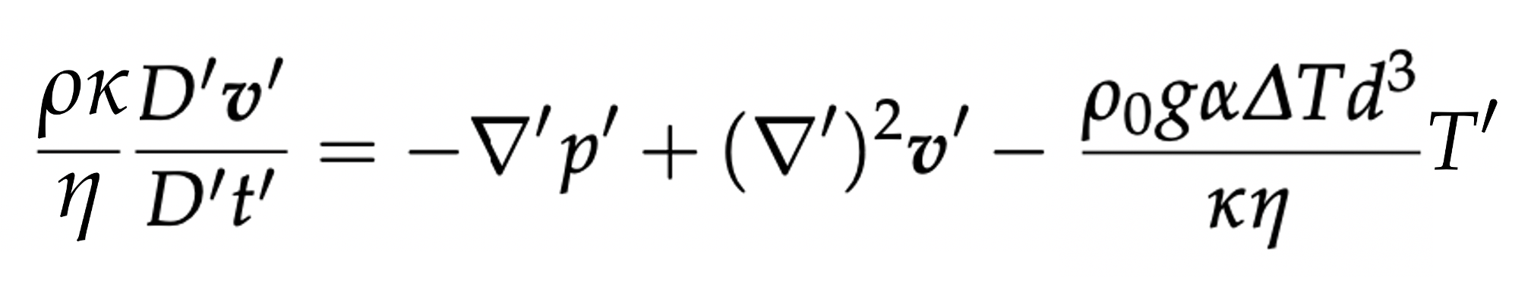
Recap: Non-dimensionalizing Stokes
We can derive simple expressions for characteristic values of each of the equation properties:
We can now normalize each of the Navier-Stokes terms by the relevant characteristic value(s) to generate a non-dimensional form of the equation
dimensional
The Prandtl Number
The Rayleigh
Number
non-dimensional

Slide 7
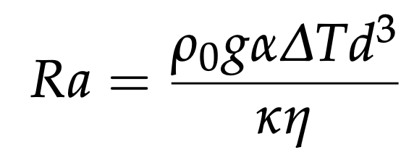
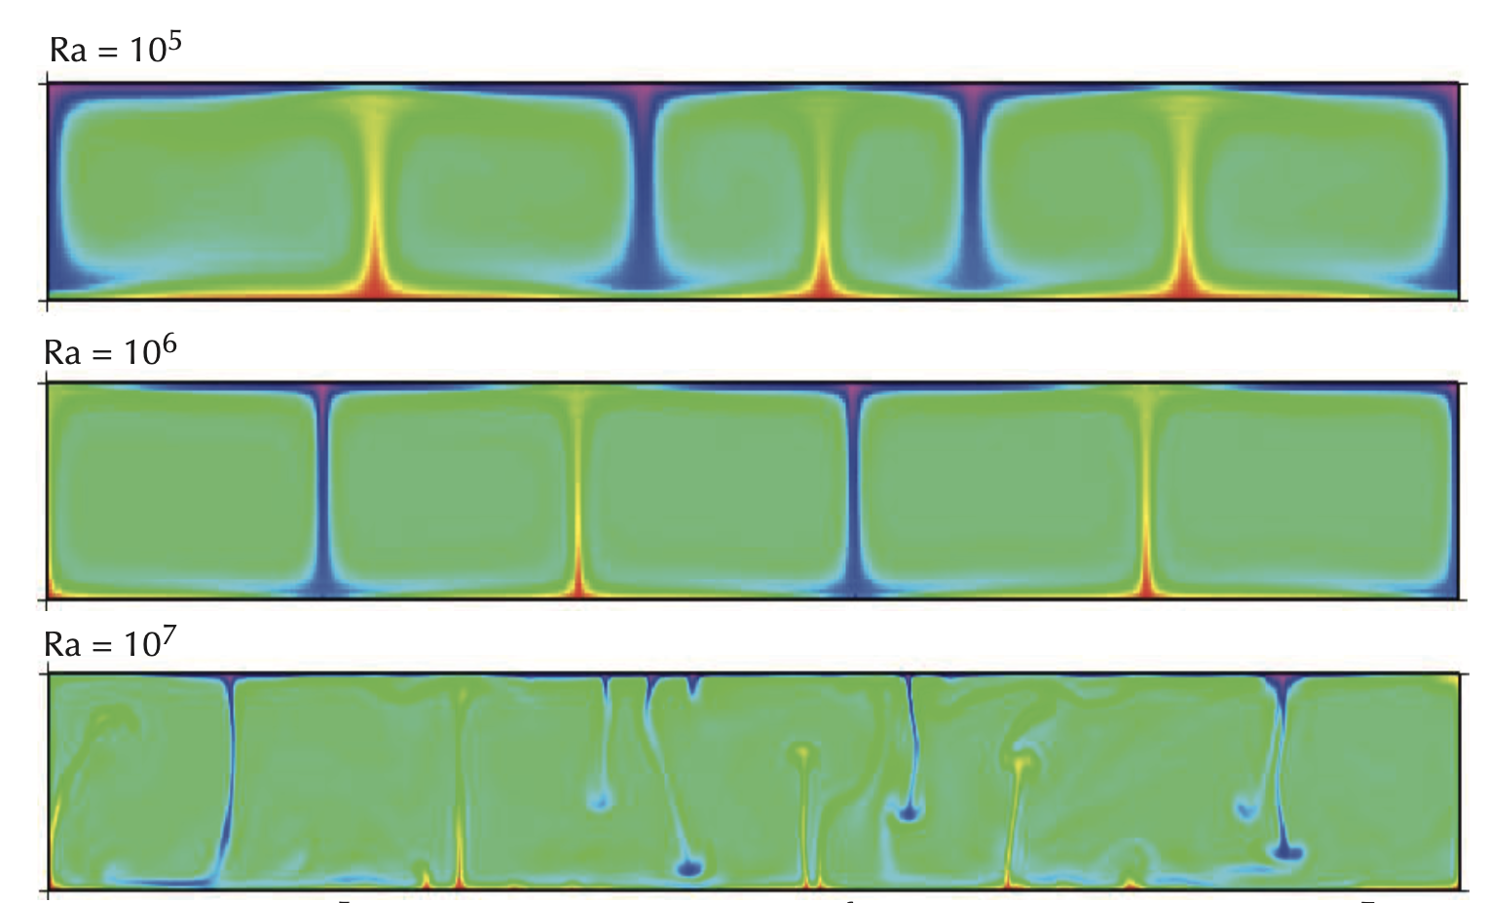
The Rayleigh Number
Increasing Ra # increases the convective vigor and decreases the relative importance of conduction
Becker and Faccenna, Tectonic Geodynamics

Slide 8
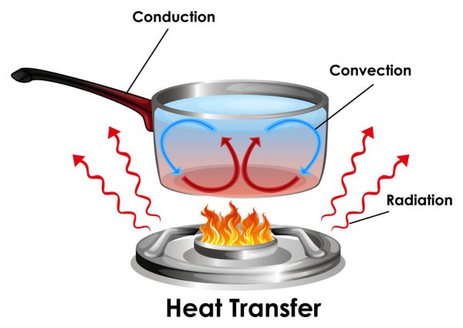
Thermal convection
Cons. energy
Cons. momentum
Becker and Faccenna, Tectonic Geodynamics

Slide 9
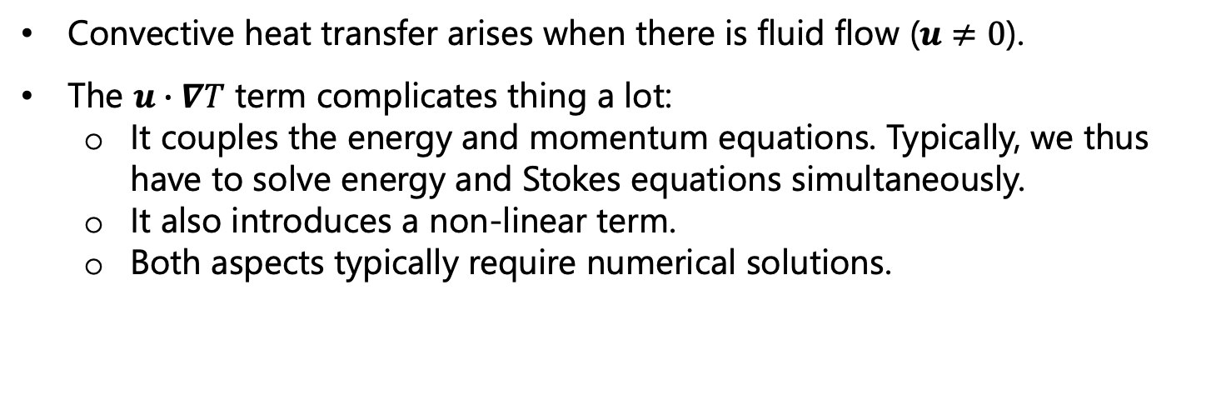
Thermal convection
Cons. energy
Cons. momentum
Convective heat transfer arises when there is fluid flow ($u≠0$).
The $u∙∇T$ term complicates thing a lot:
It couples the energy and momentum equations. Typically, we thus have to solve energy and Stokes equations simultaneously.
It also introduces a non-linear term.
Both aspects typically require numerical solutions.
Becker and Faccenna, Tectonic Geodynamics

Slide 10
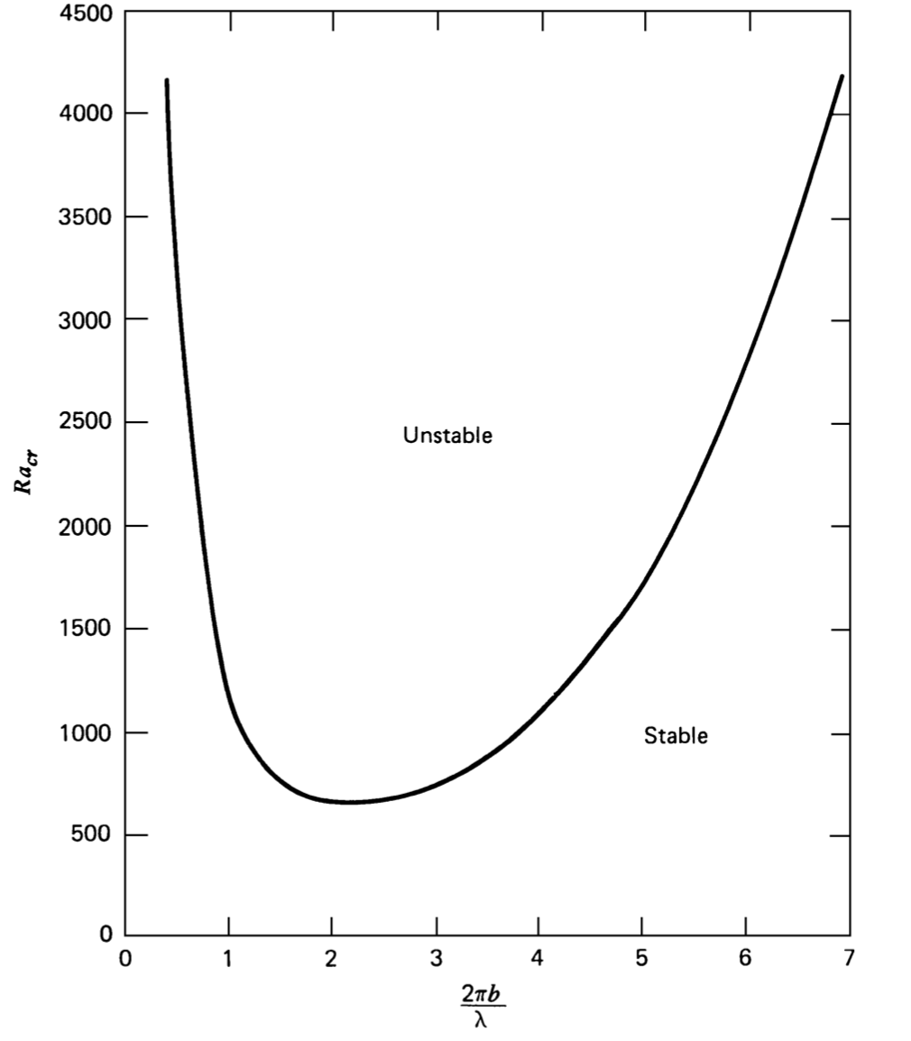
Onset of convection
Critical Rayleigh number
Aspect ratio
Turcotte and Schubert

Slide 11
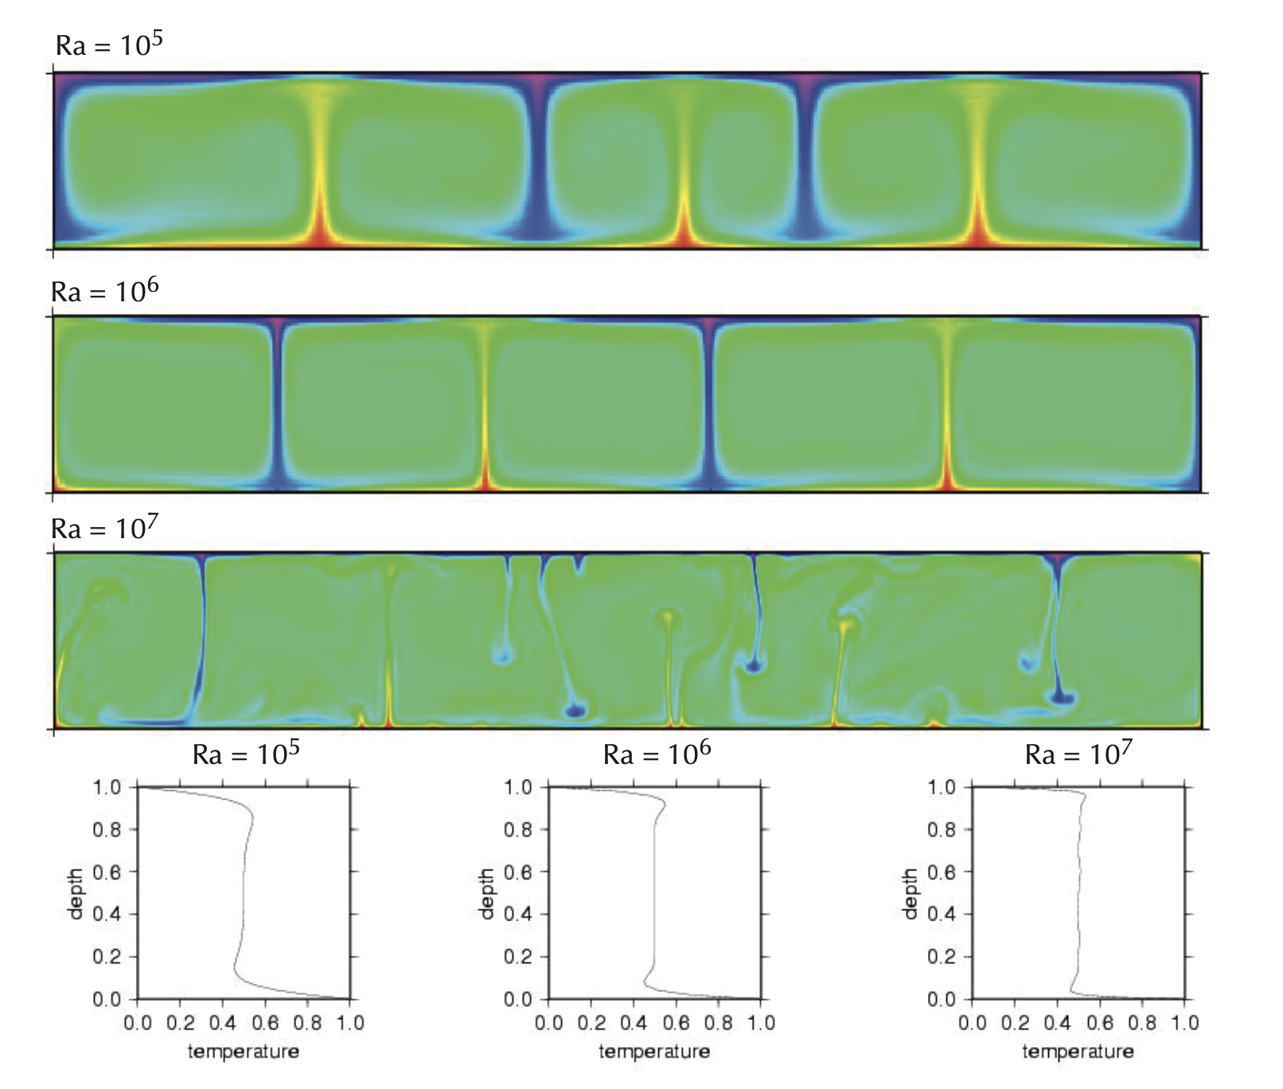
Style of convection
Different Ra # -> different style
Becker and Faccenna
Figuring out the convective regime (/style), e.g.:
What is the optimal convective wavelength?
How does surface heat flow and velocity depend on convective parameters (e.g., viscosity, temperature)?

Slide 12
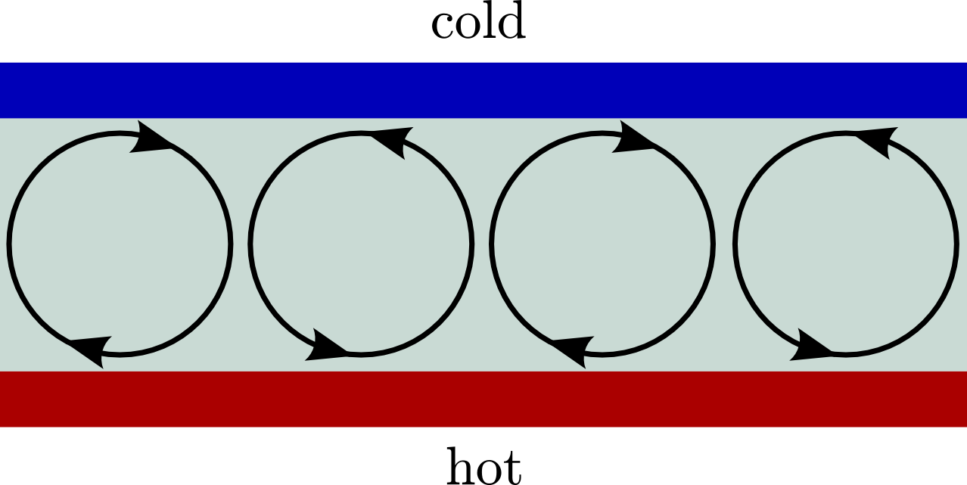
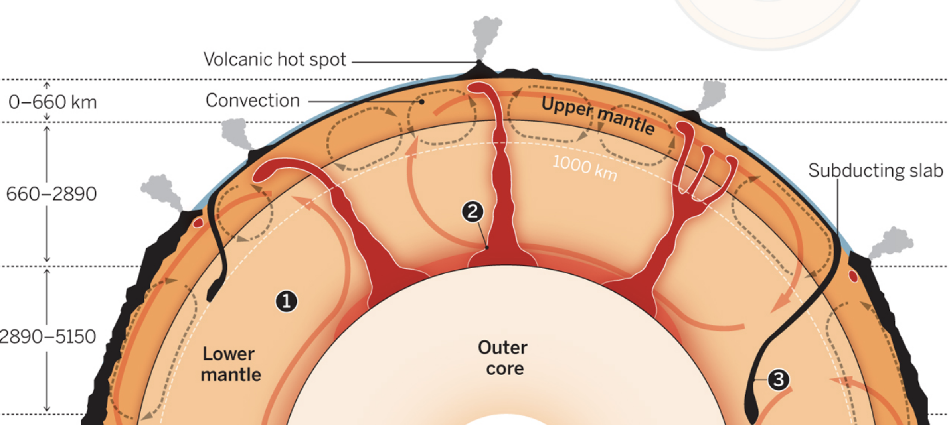
Style of convection
Finite amplitude boundary layer model (T&S, Sect. 6-21)
Rayleigh-Bernard convection (heated from below)

Slide 13
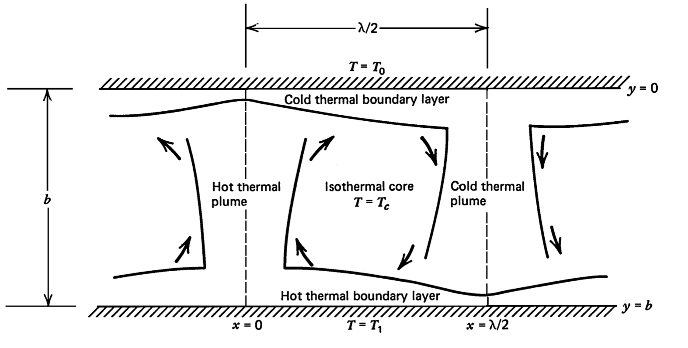
Style of convection
Finite amplitude boundary layer model (T&S, Sect. 6-21)
Rayleigh-Bernard convection (heated from below)

Slide 14
Style of convection
Finite amplitude boundary layer model (T&S, Sect. 6-21)
Rayleigh-Bernard convection (heated from below)
System basics:
Vigorous convection (Ra >> Ra_{crit.})
Fluid motions accommodate convective transport of heat.
Conduction feeds heat into hot thermal boundary layer (TBL) at base.
Conduction releases heat at the surface, forming a cold TBL.
Simplified picture above assumes symmetry -- Breaks down for more complex setups (e.g., T-dependent viscosity, mixed heating)

Slide 15
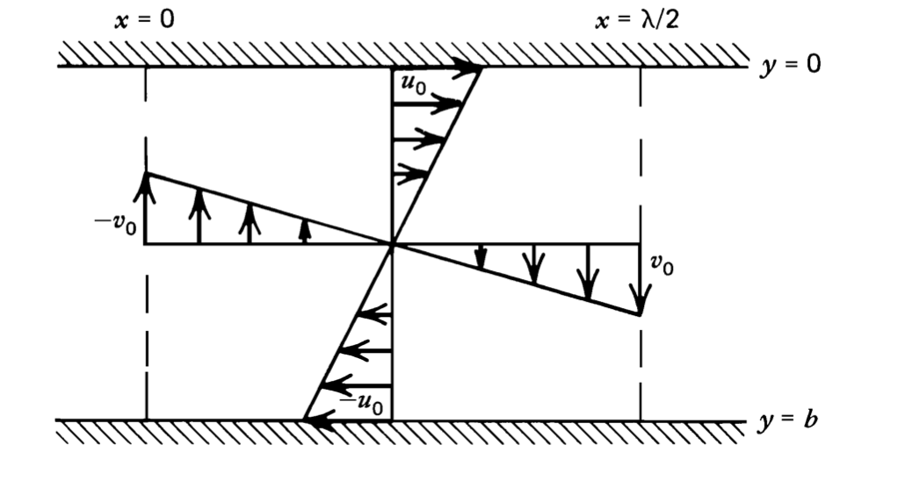
Style of convection
Finite amplitude boundary layer model (T&S, Sect. 6-21)
Rayleigh-Bernard convection (heated from below)
Assumed convection cell geometry
Approach: A force balance
(as a “full” solution of the relevant PDEs would require a numerical model)

Slide 16
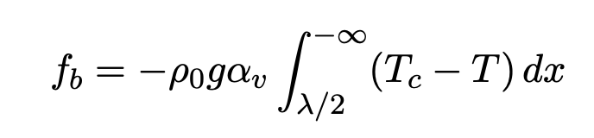
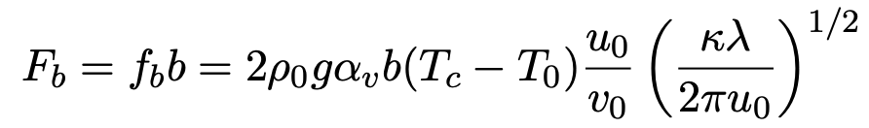
Style of convection
Finite amplitude boundary layer model (T&S, Sect. 6-21)
Rayleigh-Bernard convection (heated from below)
Downward body force per unit depth
Total downward body force (slab pull)

Slide 17
Style of convection
Finite amplitude boundary layer model (T&S, Sect. 6-21)
Rayleigh-Bernard convection (heated from below)
Downward body force per unit depth
Total downward body force (slab pull)
horizontal/vertical velocity
(= thickness of the plume relative to the boundary layer)

Slide 18
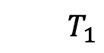
Style of convection
Finite amplitude boundary layer model (T&S, Sect. 6-21)
Rayleigh-Bernard convection (heated from below)
Downward body force per unit depth
Total downward body force (slab pull)
$$T_{1}$$
Total upward body force (plume)

Slide 19
Style of convection
Finite amplitude boundary layer model (T&S, Sect. 6-21)
Rayleigh-Bernard convection (heated from below)
Now to balance with viscous forces
$$T_{1}$$

Slide 20
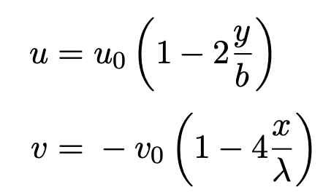
Style of convection
Finite amplitude boundary layer model (T&S, Sect. 6-21)
Convection cell geometry (“core” flow)
Velocities:

Slide 21
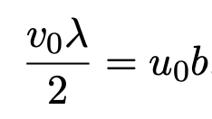
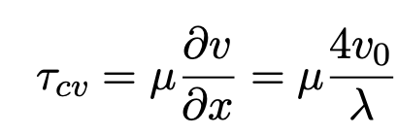
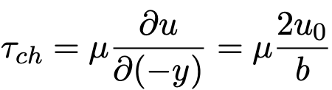
Style of convection
Finite amplitude boundary layer model (T&S, Sect. 6-21)
Convection cell geometry (“core” flow)
Velocities:
And to conserve mass:
Shear stress on vertical flow boundaries:
Shear stress on horizontal flow boundaries:

Slide 22
Style of convection
Our forces/stresses:
Buoyancy force:
Shear stress on vertical flow boundaries:
Shear stress on horizontal flow boundaries:

Slide 23
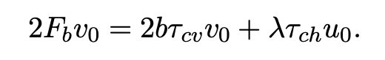
Style of convection
Our forces/stresses:
Buoyancy force:
Shear stress on vertical flow boundaries:
Shear stress on horizontal flow boundaries:
Balancing them using work:

Slide 24
Style of convection
Our forces/stresses:
Buoyancy force:
Shear stress on vertical flow boundaries:
Shear stress on horizontal flow boundaries:
Balancing them using work:
Force * distance = work done [J]
Force * velocity = rate work is done [W]

Slide 25
Sidebar: Viscous dissipation
Related to:
Force * distance = work done [J]
Force * velocity = rate of work done [W]

Slide 26

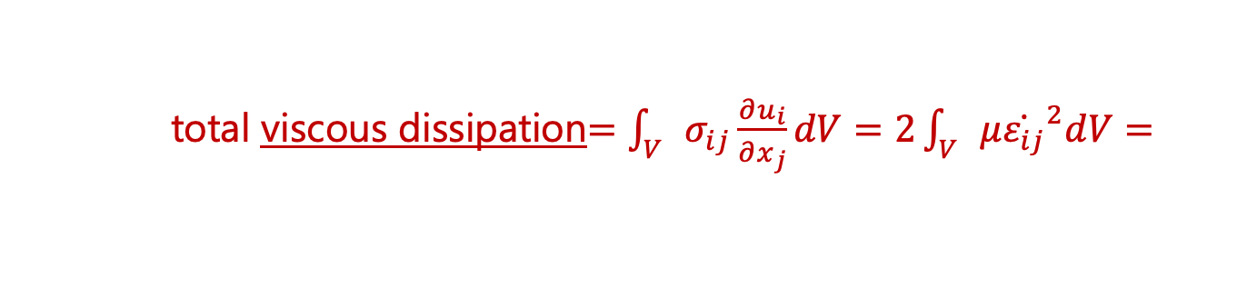
Sidebar: Viscous dissipation
Related to:
Force * distance = work done [J]
Force * velocity = rate of work done [W]
[Nm/s = W]
total viscous dissipation$=\int_{V}{σ_{ij}\frac{∂u_{i}}{∂x_{j}}dV=2\int_{V}{μ{\dot{ε_{ij}}}^{2}dV=}}$
[Pa/s]
viscous dissipation (per unit vol.) $∝$ $μ{\dot{ε}}^{2}$

Slide 27
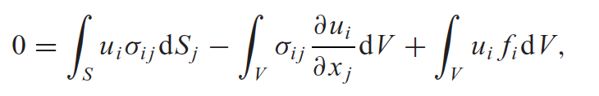
Sidebar: Viscous dissipation
Related to:
Force * distance = work done [J]
Force * velocity = rate of work done [W]
[Nm/s = W]
total viscous dissipation$=\int_{V}{σ_{ij}\frac{∂u_{i}}{∂x_{j}}dV=2\int_{V}{μ{\dot{ε_{ij}}}^{2}dV=}}$
[Pa/s]
viscous dissipation (per unit vol.) $∝$ $μ{\dot{ε}}^{2}$
Relates to the integral form of the mechanical energy equation
Work done by body forces (drives convection)
Work done on boundaries by stresses
Work done in system by stresses
Crowley and O’Connell, 2012, Geophys. J. Int.
https://websites.pmc.ucsc.edu/~fnimmo/website/viscous_flow.pdf

Slide 28
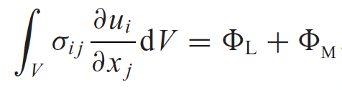
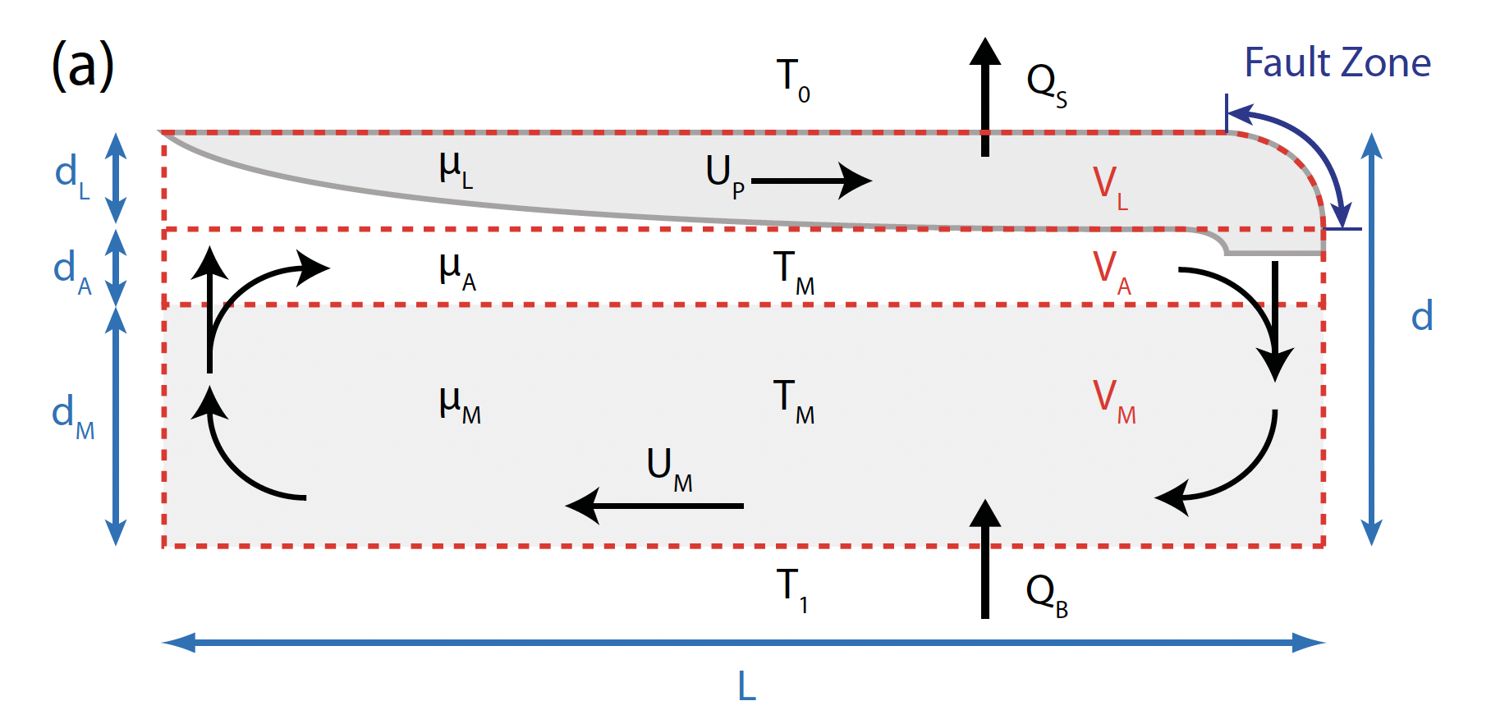
Sidebar: Viscous dissipation
Related to:
Force * distance = work done [J]
Force * velocity = rate of work done [W]
[Nm/s = W]
total viscous dissipation$=\int_{V}{σ_{ij}\frac{∂u_{i}}{∂x_{j}}dV=2\int_{V}{μ{\dot{ε_{ij}}}^{2}dV=}}$
[Pa/s]
viscous dissipation (per unit vol.) $∝$ $μ{\dot{ε}}^{2}$
Relates to the integral form of the mechanical energy equation
Work done by body forces (drives convection)
Crowley and O’Connell, 2012, Geophys. J. Int.
Work done on boundaries by stresses
Work done in system by stresses
Can use this form of the momentum eq. to do a dissipation balance
Crowley and O’Connell, 2012, Geophys. J. Int.
https://websites.pmc.ucsc.edu/~fnimmo/website/viscous_flow.pdf

Slide 29
Back to: Style of convection
Our forces/stresses:
Buoyancy force:
Shear stress on vertical flow boundaries:
Shear stress on horizontal flow boundaries:
Balancing them using work:
Force * distance = work done [J]
Force * velocity = rate work is done [W]

Slide 30
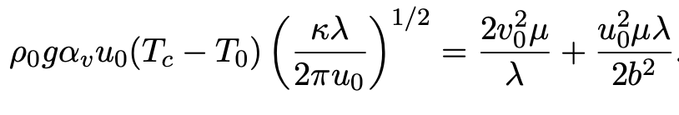
Style of convection
Our forces/stresses:
Buoyancy force:
Shear stress on vertical flow boundaries:
Shear stress on horizontal flow boundaries:
Balancing them using work:

Slide 31
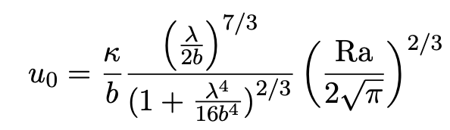
Style of convection
Our forces/stresses:
Buoyancy force:
Shear stress on vertical flow boundaries:
Shear stress on horizontal flow boundaries:
Balancing them using work:

Slide 32
Style of convection
Balancing them using work:

Slide 33
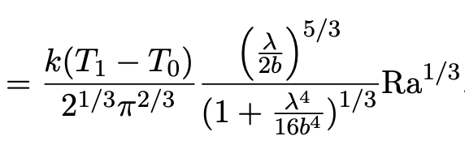
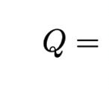
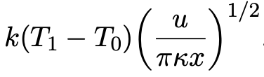
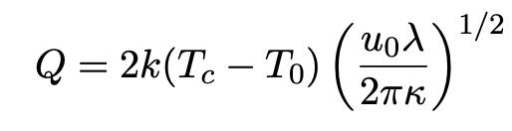
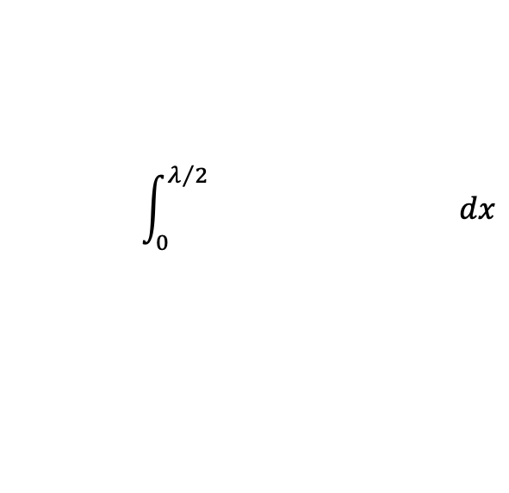
Style of convection
Balancing them using work:
Total rate of heat flow through top of the cell?
$$\int_{0}^{λ/2}{ dx}$$

Slide 34
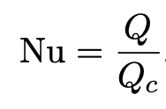
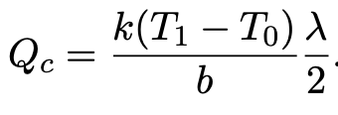
Style of convection
Balancing them using work:
Total rate of heat flow through top of the cell?
$$\int_{0}^{λ/2}{ dx}$$
Heat flow by conduction in absence of convection

Slide 35
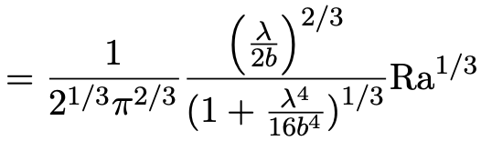
Style of convection
Balancing them using work:
Total rate of heat flow through top of the cell?
$$\int_{0}^{λ/2}{ dx}$$
Scaling between Nu # and Ra #!

Slide 36
Style of convection
Balancing them using work:
Total rate of heat flow through top of the cell?
$$\int_{0}^{λ/2}{ dx}$$
Cell geometry for which convection is most efficient (i.e., max Nu #)?

Slide 37
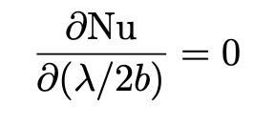
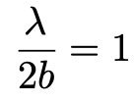
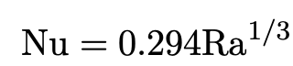
Style of convection
Balancing them using work:
Total rate of heat flow through top of the cell?
$$\int_{0}^{λ/2}{ dx}$$
Cell geometry for which convection is most efficient (i.e., max Nu #)?
and

Slide 38
Style of convection
From before:

Slide 39
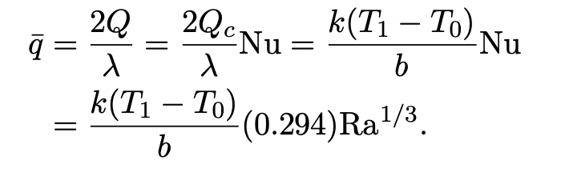
Style of convection
From before:
Average surf. heat flux:

Slide 40

Style of convection
From before:
Average surf. heat flux:
With Earth-like parameters:
$\overline{q}≈200 mW/m^{2}$ and $u_{0}≈84 mm/yr$
Both ~2 times average Earth values. Not bad.

Slide 41
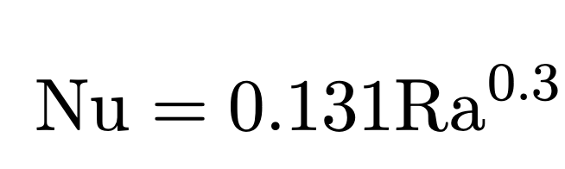
Style of convection
From before:
Average surf. heat flux:
With Earth-like parameters:
$\overline{q}≈200 mW/m^{2}$ and $u_{0}≈84 mm/yr$
Both ~2 times average Earth values. Not bad.
Note: These scaling will vary for different setups. E.g., for no slip boundaries:

Slide 42
These simple problems help us build intuition and can be compared with numerical and lab experiments.
However, Earth much more complex

Slide 43
These simple problems help us build intuition and can be compared with numerical and lab experiments.
However, Earth much more complex
What are some important aspects neglected in the simple (i.e., Rayleigh-Bernard) convective system considered?

Slide 44
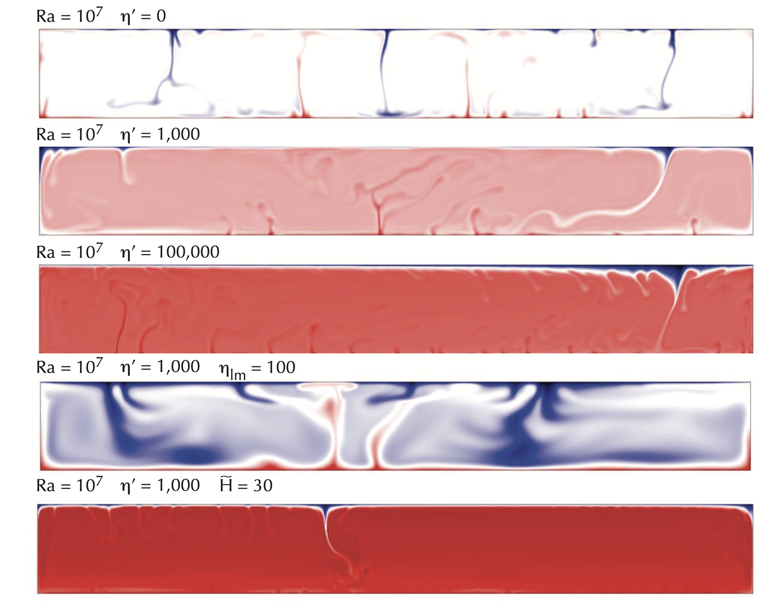
e.g., lateral viscosity variations, heat production, more complex rheology, thermo-chemical, phase changes, …

Slide 45
e.g., lateral viscosity variations, heat production, more complex rheology, thermo-chemical, phase changes, …
For more complex setups, need more than the Ra # to describe the convective regime

Slide 46
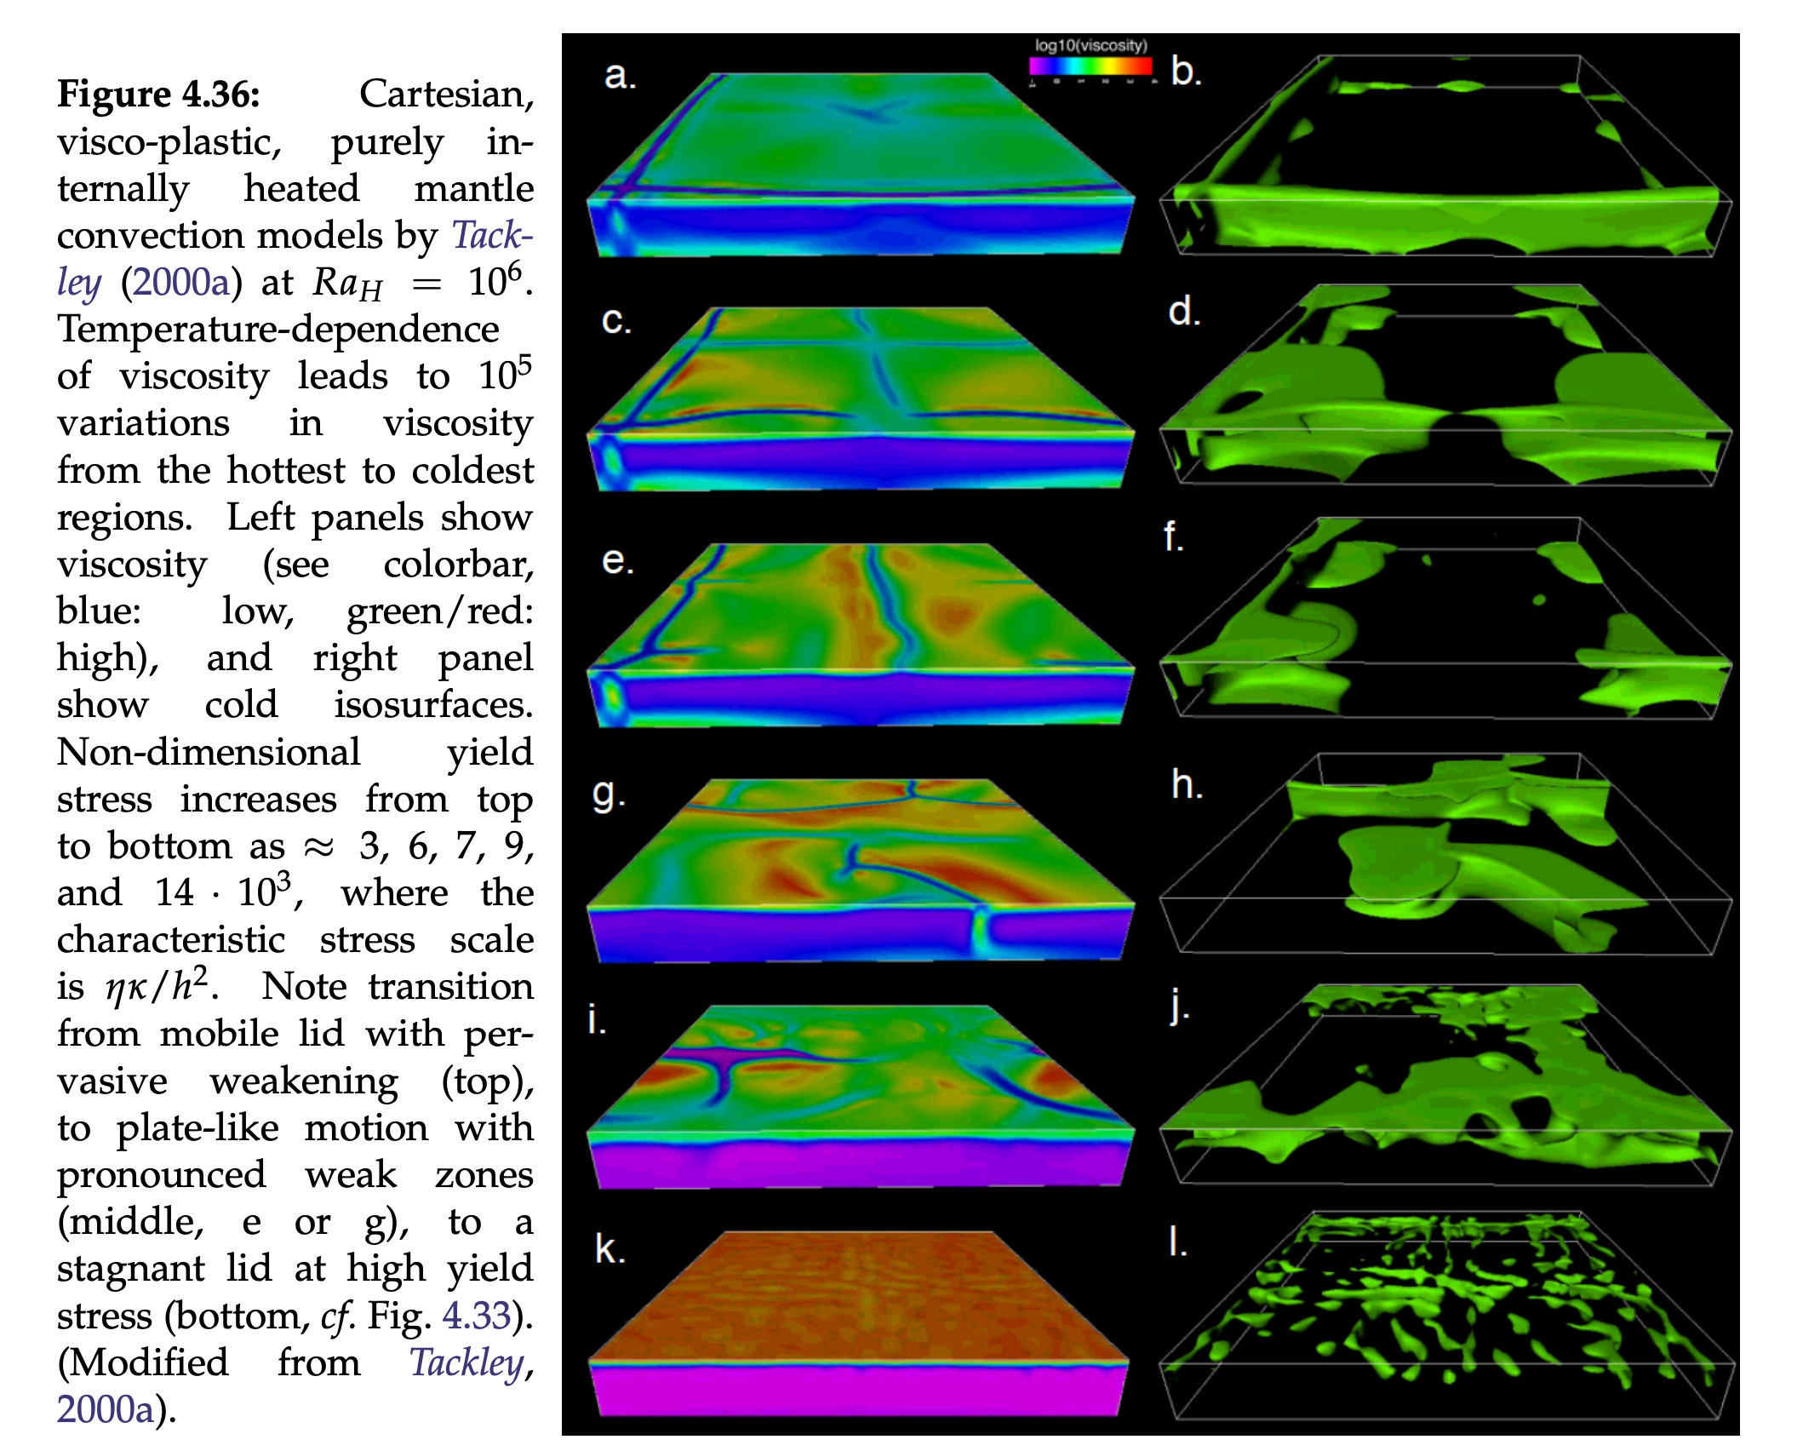
Plastic yielding seems needed to generate weak plate boundaries (i.e., plate tectonics)
Becker and Faccenna, Tectonic Geodynamics

Slide 47
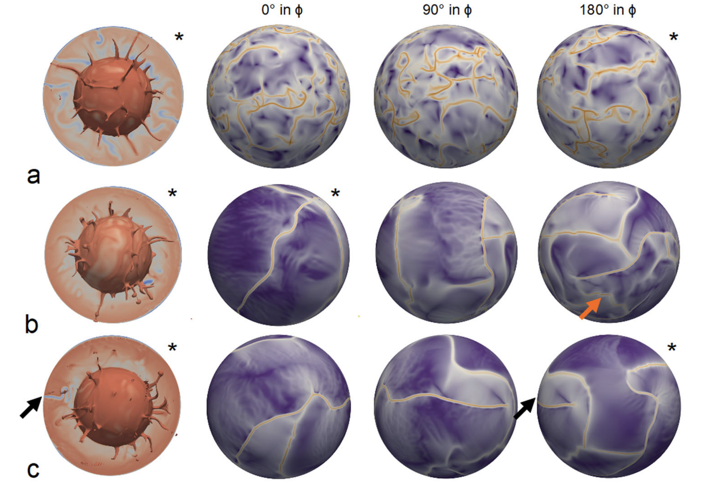
Trickiest part: Creating transform faults/plate boundaries
Yield
stress increase
Langemeyer et al., 2021, Nat. Comm.

Slide 48

How does mantle convection (and oceanic plate subduction) organize in the presence of thick/stiff/buoyant continents?
Becker and Faccenna, Tectonic Geodynamics

Slide 49

Earth convection: Slabs, plumes, background flow
Impacts/produces: Earth cooling, Earth density structure, Plate velocities, the geoid, dynamic topography, …

Slide 50

Take homes:
Thermal convection couples the energy and momentum equations.
Assuming a simple convection cell geometry, can use a force/work balance to derive scaling between convection parameters (e.g., Nu $∝$ Ra^{1/3} for Rayleigh-Bernard).
Full solutions of PDEs require computers and enable us to incorporate Earth’s many additional complexities: e.g., viscosity variations, complex rheologies, chemical effects, phase changes, plate yielding…

